Slide 1
EPID Record
Kay Kasemir
July 2026

Slide 2
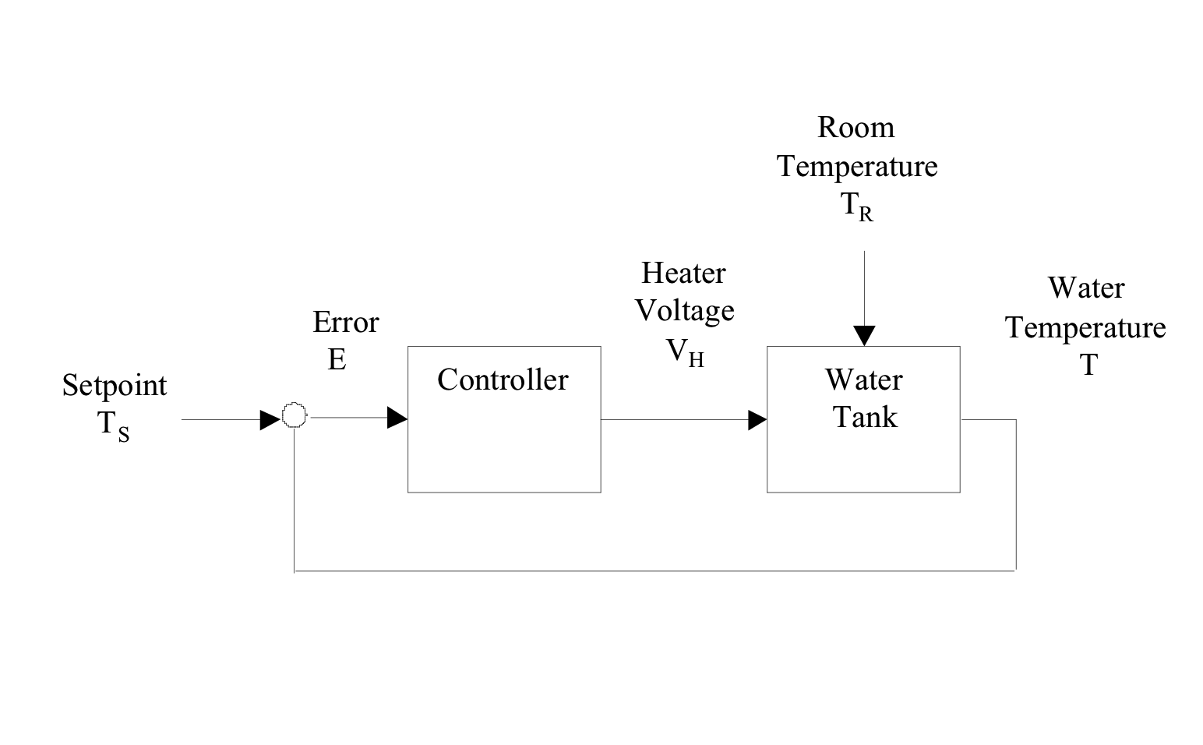
PID Control: Old but still prevalent
Basic Recipe
Increase K_{P} until system oscillates, back off a little
Increase K_{i} to eliminate residual error
Maybe use K_{D} to dampen overshoot
See also “Ziegler-Nichols” and many control system theory books
Typical control loop
PID Controller
  O(n) = K_{P} E(n) + K_{I}Σ_{i}E(i) dT + K_{D} [E(n)-E(n-1)]/dT
  Update period dT
  Error readings E(n)
  Output O(n)
  Proportional Gain K_{P}, Integral K_{I}, Derivative K_{D}
-

Slide 3
Why does EPICS base not include a PID record?
How to define?
  P, I, D gains with
  O(n) = K_{P} E(n) + K_{I}Σ_{i}E(i) dT + K_{D} [E(n)-E(n-1)]/dT?
  K_{p} applied to all terms?
  O(n) = K_{P}(E(n) + K_{I}Σ_{i}E(i) dT + K_{D} [E(n)-E(n-1)]/dT)?
  P gain K_{p}, Integration time T_{i}=K_{p}/K_{i}, Derivative time T_{d}=K_{d}/K_{p}?
Avoid integral windup?
  Limit abs(error sum) < max
  Reset error sum whenever setpoint changes
    Start over for new setpoint
  Reset error sum when error > “Integration Zone”
    Only use K_{i} to fine-tune once error is small, within IZone
➔ Collection of CALC records, original PID record,
“Controlled” CPID record, “Enhanced” EPID record

Slide 4
EPID Record
Included in APS synApps “std” module
VAL is the setpoint
INP reads current value
Error sum limited to [DRVL, DRVH]
Applies K_{P}, K_{I}, K_{D} gains as output= K_{P}(err + K_{I} sum + K_{D} diff)
FBON=1 to enable feedback
Output is limited to [DRVL, DRVH]
Writes to OUTL

Slide 5
About the example
Showing EPID record now as follow-up to PID-using-CALC
.. but EPID record is not included in EPICS base, i.e., unknown to the “softIoc” we used so far!
Usage of “makeBaseApp.pl” to create IOCs with additional modules will be detailed later

Slide 6
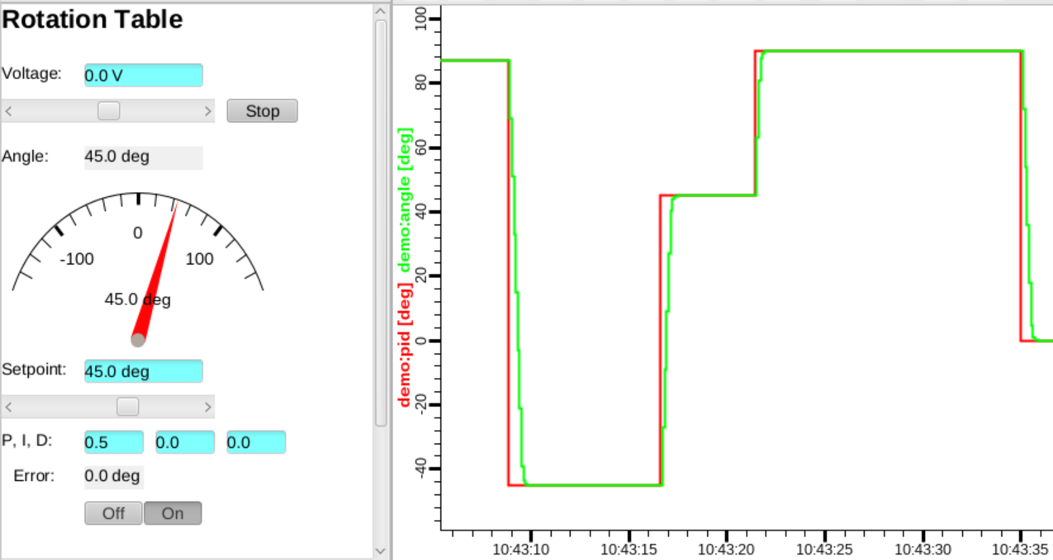
Example
IOC
cd /ics/examples/02b_epid
cat pidApp/Db/rotation_control.db
﻿cd iocBoot/iocpid
./st.cmd
Display
In CSS, File/Open ﻿/ics/examples/02b_epid/rotation_control.bob
Turn feedback “On”, change setpoint, tweak P, I, D
record(epid, "$(S):pid")
{
field(DESC, "PID controller")
field(EGU, "deg")
field(PREC, "1")
field(SCAN, ".1 second")
field(INP, "$(S):angle")
field(KP, "0.5")
field(DRVL, "-12")
field(DRVH, "12")
field(OUTL, "$(S):voltage PP")
}

Slide 7
‘EPID’ Record
Currently the preferred EPICS PID record
For more, see
  https://github.com/epics-modules/std
  https://github.com/epics-modules/std/blob/master/docs/epidRecord.md

